Slide 1
BSEN 5250/6250
Deterministic Modeling for Biosystems
Lecture 3
Simulation of Biological Processes
Reading: Jones and Luyten, 1998

Slide 2
Introduction
Biological systems are made up of interacting chemical and physical processes.
Living systems are composed of many subsystems and components, each with its own unique characteristics and behavior that contributes to the overall form and function of the entire system.
Biological systems are highly complex, and have many non-linear interactions that must be understood to predict system behavior

Slide 3
Defining a System
System - consists of elements or interconnected components that are grouped together for the purpose of studying some part of the real world
System Boundary – An abstraction that separates the system from the environment. It is used to identify the system and isolate it for further study.
Boundary
System & subsystems
Inputs
Outputs

Slide 4
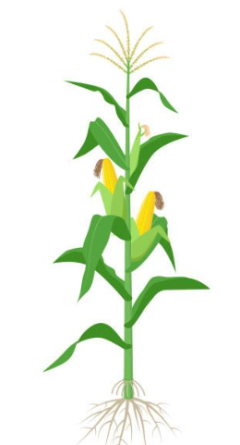
What Crosses System Boundary?
CO₂
Water
Temperature
Nutrients
Solar Radiation
Seeds

Slide 5
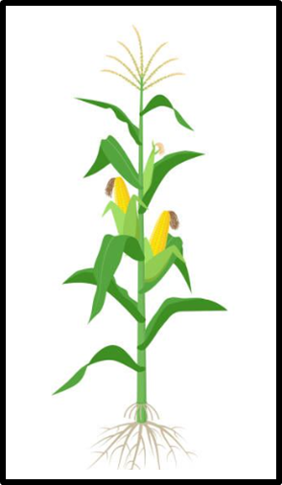
Develop a Model
CO2
Water
Temperature
Nutrients
Solar Radiation
Seeds
Seeds

Slide 6
Computer Simulation
Process of solving the mathematical model by developing a computer program. This involves developing the program logic, numerical techniques, and user interface.

Slide 7
Inputs and Outputs
Inputs are environmental factors that influence system behavior but are not influenced by the system.
Outputs represent the characteristic behavior of the system that is of interest to the modeler.

Slide 8
Parameters and Constants
Characteristics of the model that are constant throughout the simulation
Constants are usually are stable across experimental environments (eg. CO₂)
Parameters may vary across environments, but are constant for the period of simulation (pH)

Slide 9
State Variables
Quantities that describe the condition of the system components
State variables change with time and/or space
A model may have one or many state variables, depending upon interest of the modeler and the importance of the state of the system under consideration

Slide 10
Process Models
Models that mathematically represent physical, chemical or biological processes to compute the state of the system
Contrast this with an empirical model that treats the system as a black box and computes outputs as a function of inputs rather than the integration of system subcomponents
Yield = 1.25 * Nitrogen

Slide 11
Process-Oriented Soybean Growth Model
PHOTOSYNTHETIC
EFFICIENCY
TEMPERATURE
LIGHT
DAYLENGTH
RATE
PHOTOSYNTHESIS
LEAF
AREA
LEAF
MASS
DEVELOPMENT
STAGE
CARBON
RESERVES
PARTITIONING
STEM
MASS
DAILY
GROWTH
SEED
MASS
SHELL
MASS
CONVERSION
EFFICIENCY
ROOT
MASS
MAINTENANCE
RESPIRATION

Slide 12
Verification – The process of debugging, or verifying if the compute code is an accurate representation of the underlying mathematical model
Calibration – The process of making adjustments to model parameters to give the best fit between simulated and observed results
Validation – The process of comparing simulated results to real system data not used for calibration or parameter estimation.

Slide 13
Simulation Approach
Objectives – what question are we trying to answer?
Define System – boundary and system components
Literature review – what is known about the system?
Model development – define mathematical relationships
Evaluation – evaluate the accuracy of the model
Sensitivity Analysis – explore behavior of model
Application – apply model to optimize system management

Slide 14
Compartmental Models
Compartment is a quantity or level of a state variable and represents the state of a system
Compartments represent the state variables in a system
Emphasis on flow and storage

Slide 15
Forrester Diagram Symbols
Level or State
Rate
Source
Auxiliary Variable
Information flow
Pathway

Slide 16
Water Tank Example
Rate Variables
i(t) - input rate
f_{1,2}(t) - flow from tank 1 to 2
O(t) - flow out of tank 2
H1 - height of water in tank 1
H2 - height of water in tank 2
i(t)
A1
V1
Constants
A1 - area of tank 1
A2 - area of tank 2
State Variables
V1 - Volume of tank 1
V2 - Volume in tank 2
H1
f_{1,2}(t)
A2
V2
H2
O(t)
Goal: Develop a mathematical model to compute the volume of water in Tank 1 and Tank 2 over time

Slide 17
i(t)
Source
i(t)
A₁
V₁
V₁
H₁
f_{1,2}(t)
F _{1,2}(t)
V₂
A₂
V₂
O(t)
H₂
Sink
O(t)

Slide 18
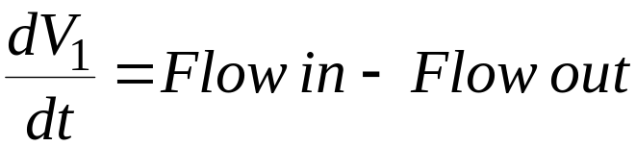
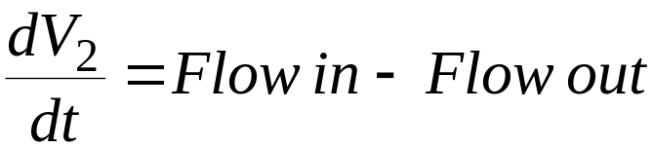
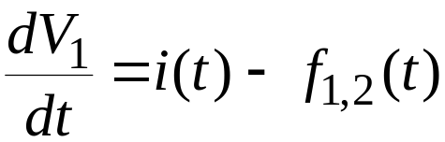
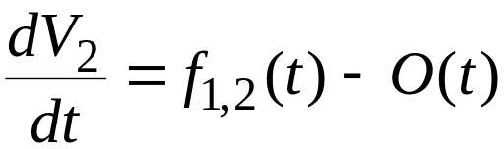
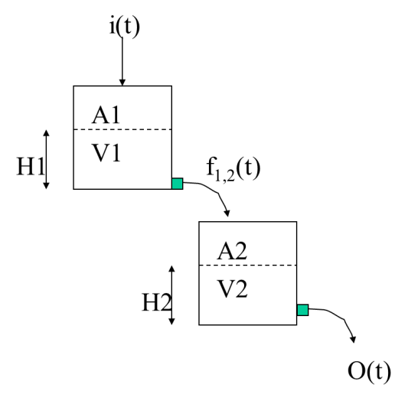
State Variable Equations
Tank 1 Equation
Tank 2 Equation

Slide 19


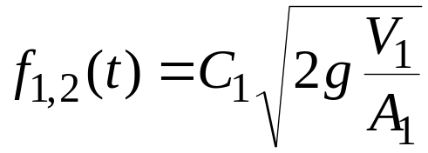
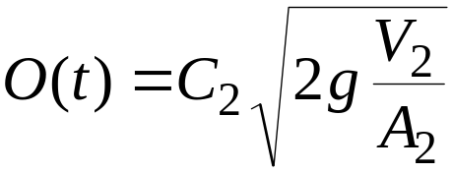
Rate Equations
Tank 1 Equation
Tank 2 Equation
V₁=A₁*H₁
V₂=A₂*H₂
C = orifice coefficient, m²-s/hr
g = gravitational constant, m/s²

Slide 20
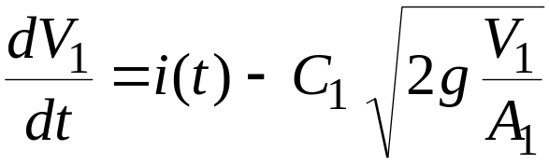
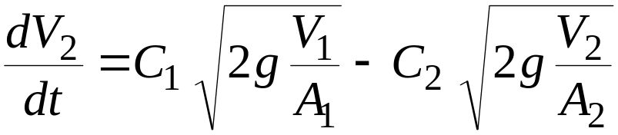
Plug Rate into State Equations
Initial Conditions: V₁, V₂
Boundary Conditions: i(t)

Slide 21
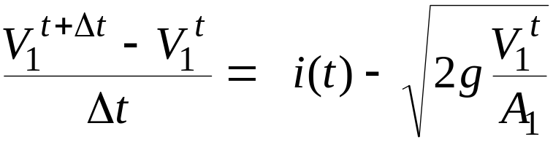
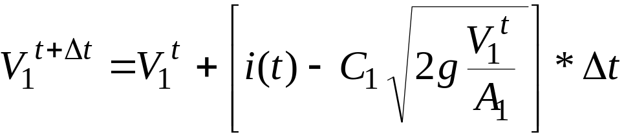
Use Euler’s Method to Compute Volume 1
V(t+dt)
V(t)
dt
Time

Slide 22
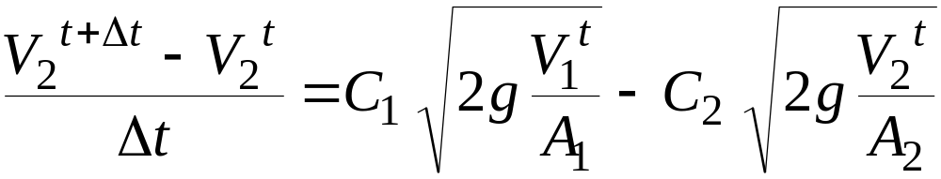
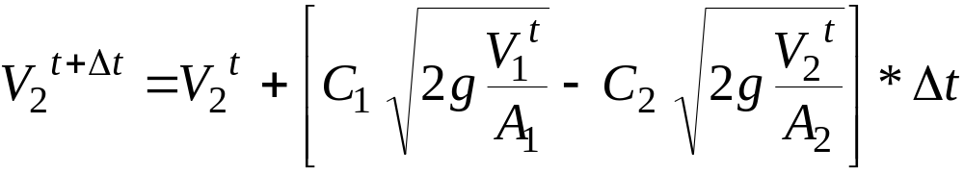
Use Euler’s Method to Compute Volume 2

Slide 23
